Slide 1

BIO-SUSHY General overview
NAME OF EVENT
Name of presenter
DD/MM/YYYY

Slide 2
Introduction
You may have assumed PFAS
without knowing it
PFAS, What?
PFAS (per and polyfluorinated alkyl substances) provide excellent water and oil repellency properties.
Why is it a problem?
PFAS are known as ‘forever chemicals’ due to their resistance, widespread, and linked to environmental and health problems like cancer and decreased fertility.
How?
Exposure could happen through eating, drinking, or using consumer products containing PFAS.
2

Slide 3
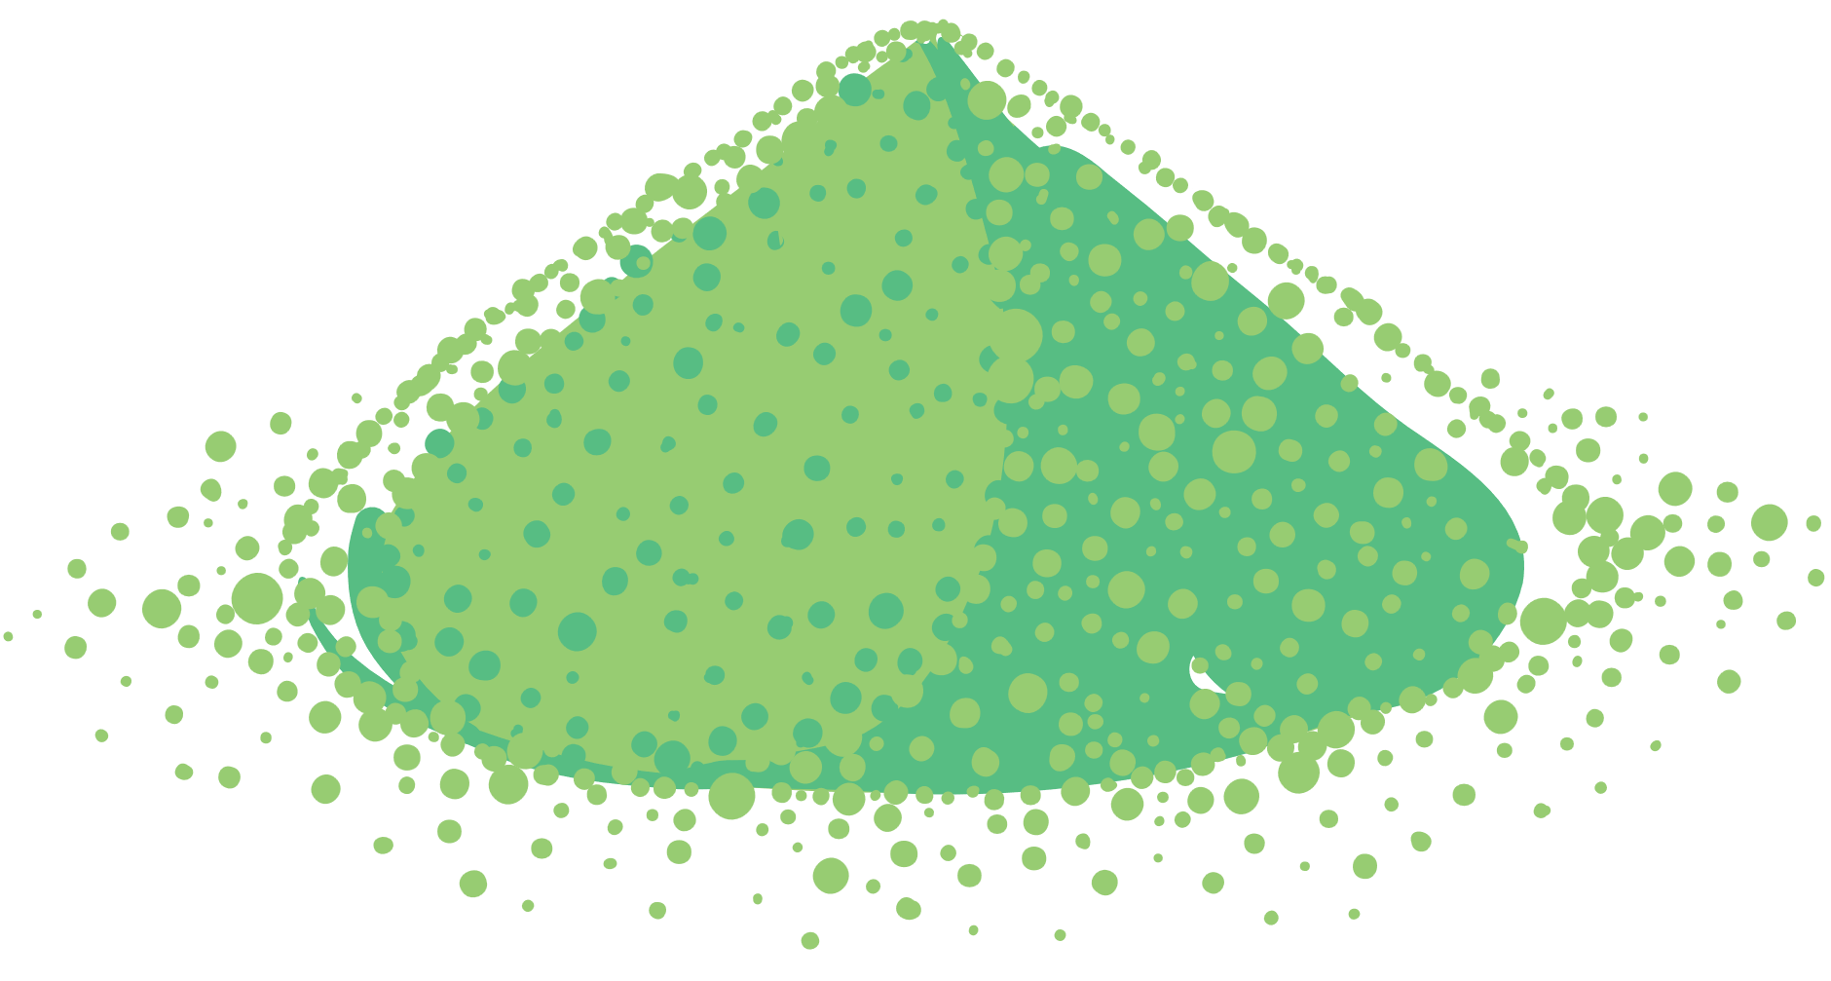
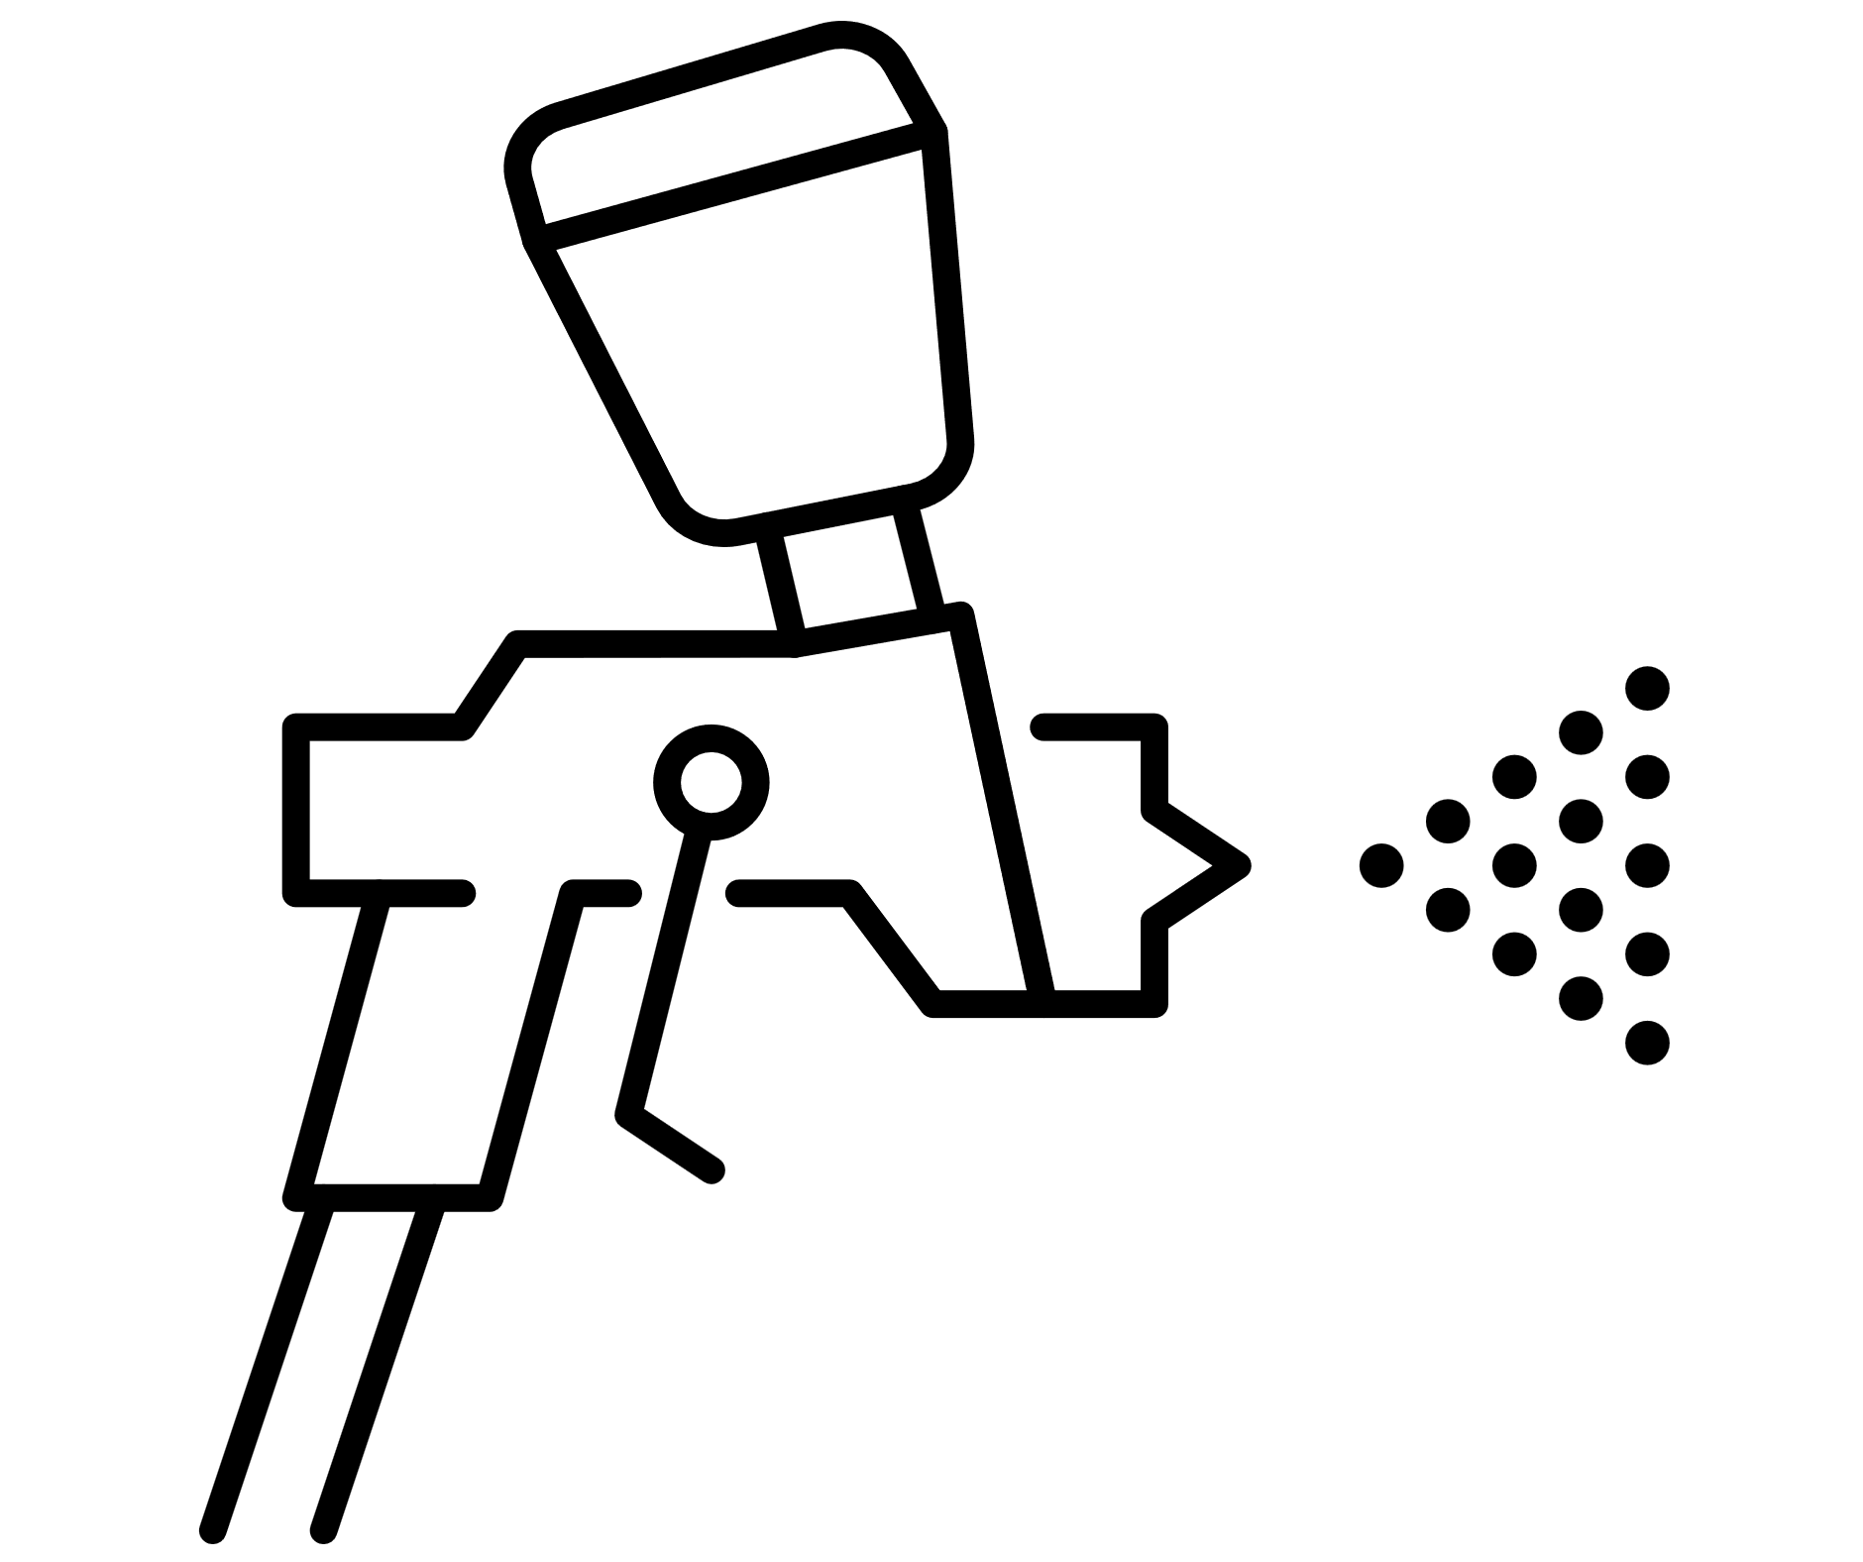





Objectives
Develop 3 PFAS-free bio-based coatings
Thermoplastic bio-based powder
Water-based hybrid sol-gel organic
Hydro/oleophobic additives
Solvent-based hybrid sol-gel inorganic
3

Slide 4







BIO-SUSHY Methodology – Based on 3 pillars
SAFE AND SUSTAINABLE BY DESIGN
R&I COATING DEVELOPMENT
MODELLING
4

Slide 5


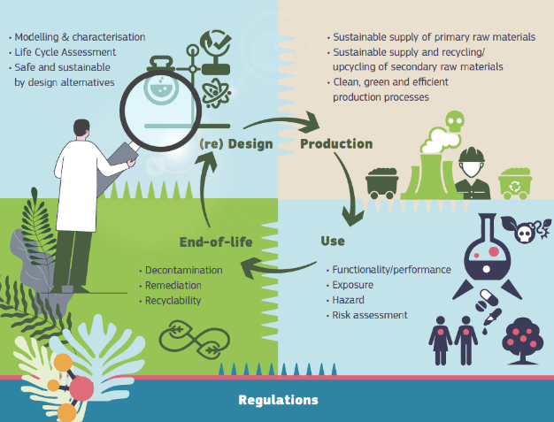
Safe and Sustainable by Design
Development of SSbD Framework applied to PFAS-free coatings
safe by material design,
safe by process design,
toxicological studies,
LCA, LCC, SLCA
Standardisation roadmap
SAFE AND SUSTAINABLE BY DESIGN
5
Notes:
Safe and sustainable by design (SSbD): approach that focuses on providing functional materials/products, while avoiding damage to human health or the environment as a consequence of their fabrication process, use or disposal.
Identifying and minimizing, at an early phase of the innovation process, the impacts concerning safety and sustainability, minimizing the environmental footprint, in particular regarding climate change and resource use and, protecting ecosystems and biodiversity, taking a lifecycle perspective. SSbD approach addresses the safety and sustainability of the material/ chemical/ product and associated processes along the whole life cycle, including all the steps of the research and development (R&D) phase, production, use, recycling and disposal.

Slide 6

The 5 steps SSbD framework
Coating development
Functional modelling
Data mining
Up-scaling
Life Cycle Costing (LCC)
Social-LCA
Re-Design
Step 5
LCA
Circularity
End of life
Data mining
QSAR
4
Step 4
Step 1
Step 2+3
Occupational monitoring
Risk assessment
Tox testing
6
Notes:
Added some animation to make it easier to follow, and readjusted the color scheme.

Slide 7

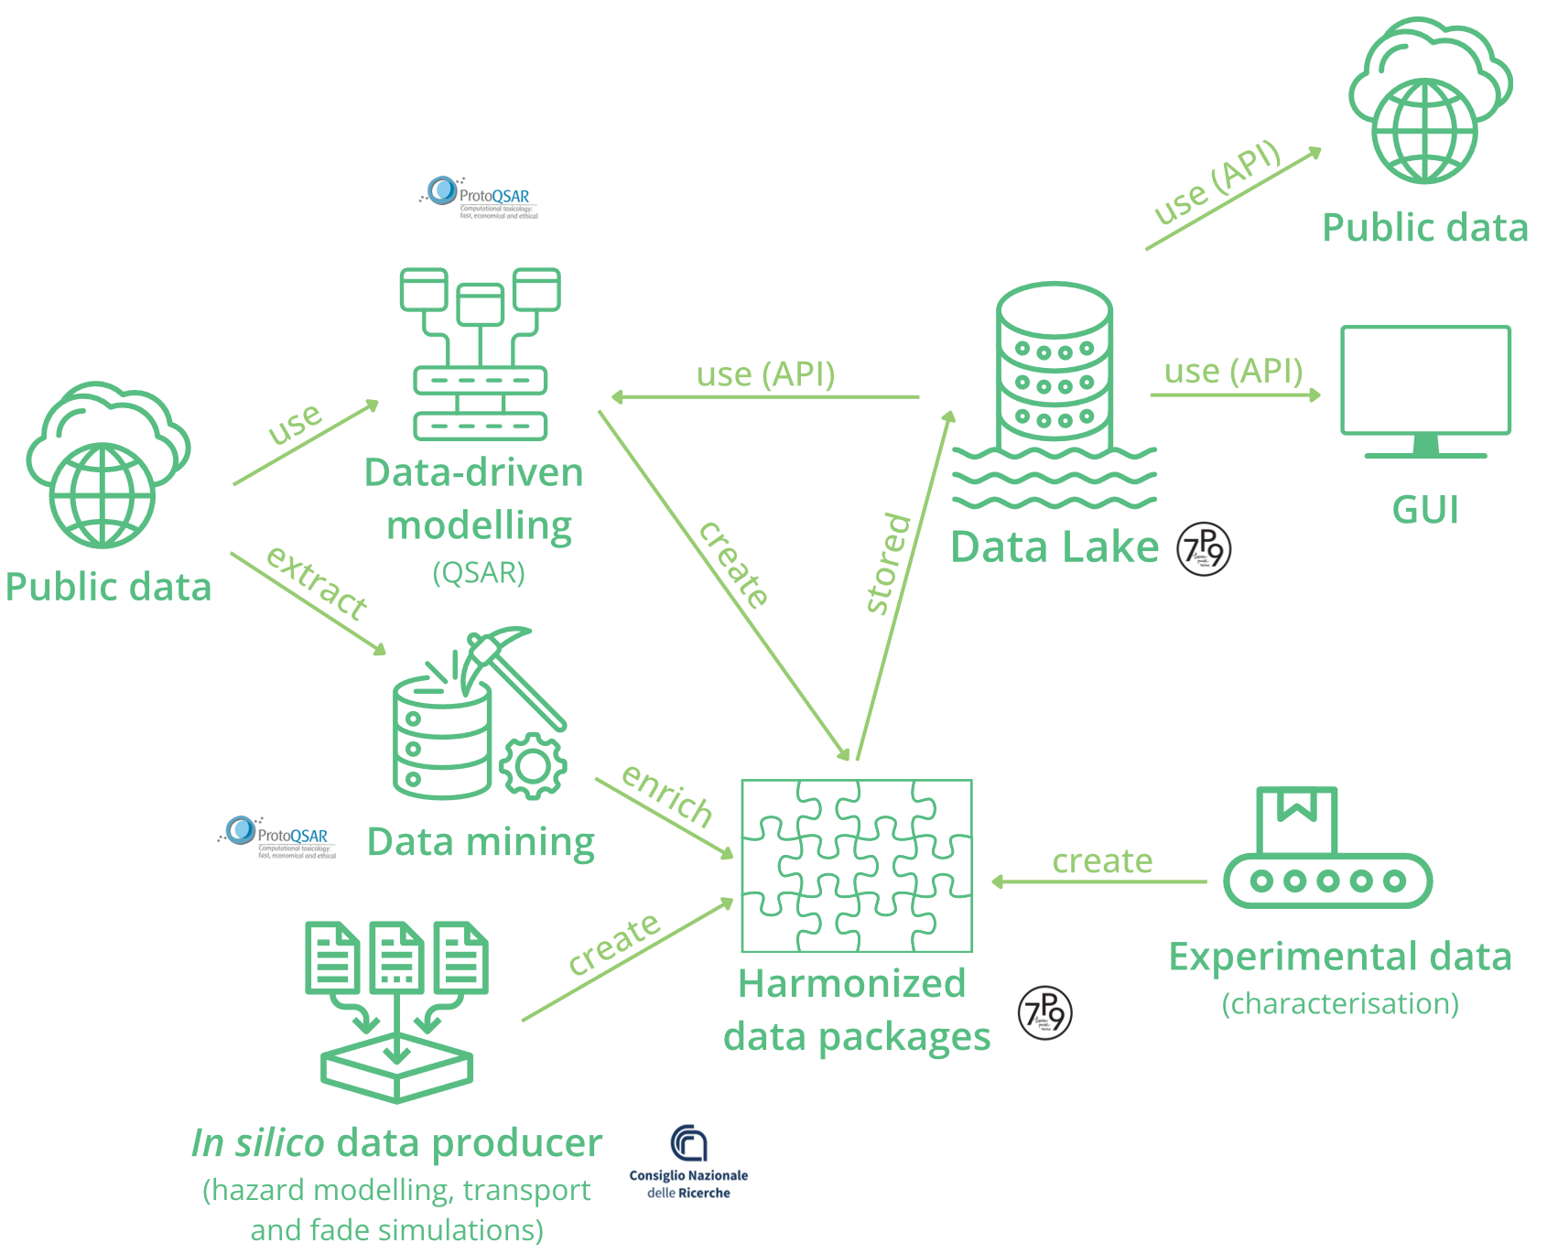
Modelling
Development of the BIO-SUSHY set of computation tools for SSbD of coatings
Development of integrated approaches supported by the BIO-SUSHY HUB for effective data management and sharing
7
Notes:
The figure represents the BIO-SUSHY data management concept. Data from different sources, like experiments, computational approaches, and online resources, are combined into a big storage called a "data lake."
This combined data is then used to create computer models that guide the SSbD decisions to develop new coatings. Finally, those data can also be shared with public databases.

Slide 8

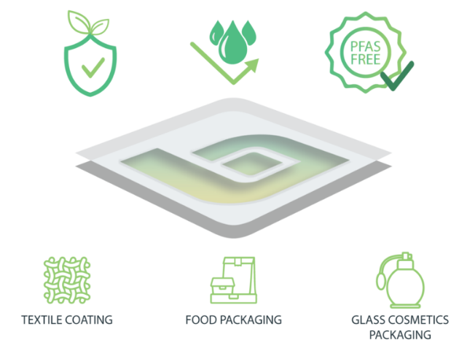
R&I Coating Development
Development of 3 novel SSbD coatings materials with water and oil repellency
Validation of coating materials with 3 case studies
Textile
Food packaging
Glass packaging
8

Slide 9
TEXTILE
9

Slide 10
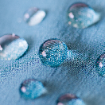








Hybrid Sol-Gel Coating for Textile
PFAS provide functional properties as water and/or oil repellency, stain resistance, soil protection to textile products, including home textiles
Fiber transformation into thread
Weaving
Bio-based content: up to 30%
Compatible with textile recycling
Applicable by current process (padding): short duration and fast curing at max 195°C
Improving coating adhesion to textile (good washing resistance) while keeping aspect and textile feeling
Combination of water-based sol gel chemistry, polyacid epoxy functions and the addition of functional additives
Pretreatment
Dye and printing
Finishing
10

Slide 11
FOOD PACKAGING
11

Slide 12

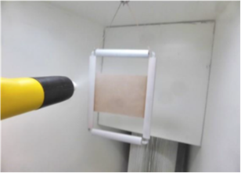


Bio-based Thermoplastic Food Trays
PFAS used for short-term storage or for holding freshly prepared food to provide functional properties as water and/or oil repellence.
Direct exposure
Emission through incineration
Accumulation in recycling or landfill
Thermal resistance
Low impact on price
Limited release of components
Validation tests: food contact tests on food trays
Water and oil repellency with 100% replacement of PFAS
No element that could impact the recyclability/compostability
Development of bio-based thermoplastic powder coating coatings based on safe compounds
12

Slide 13
GLASS PACKAGING
13

Slide 14
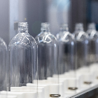
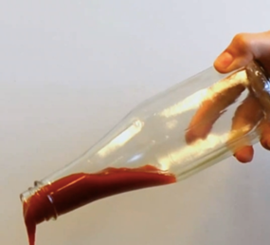
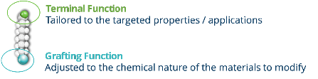

Hybrid Sol-Gel Coating for Glass Packaging
Allow high liquid sliding without leaving any residue on the surface
Reduce waste (up to 25%)
Facilitate reuse of the container (easy cleaning)
Aesthetics: keep clean surface (crucial for cosmetic)
Transparency/translucency
Compatible with industrial process (spray, curing)
Requirements of packaging and particularly cosmetic industry
Hybrid PFAS-free hybrid sol-gel coatings for water & oil repellence
Solvent based with high inorganic content and bio-based content up to 25%
Neutral coating to avoid migration from both side of the coating with a very limited release that would not alter the emulsion (skin contact, flavour…)
14

Slide 15




Impacts
25% reduction of environmental impact
Contribution to SSbD criteria and guiding principles
Reduction of PFAS
in the environment
Computational tools to support SSbD concepts
15

Slide 16




SWOT Analysis
Reduction of PFAS
Safer water & oil-repellent bio-based coatings
SSbD criteria supported by data-driven modeling
Standardization protocols
Coating validation in three markets
Social acceptance
Fulfillment of industry requirements
Further investments for development & upscaling
Meet optimal recyclability and compostability options of the advanced materials
Keep competitiveness with fossil-based
S
W
High end-user and market demand for sustainable and safer coatings
European policies to support circular strategies
Contribution to green jobs
Help businesses and SMEs
O
T
Financial, legal, and regulatory constraints
Competition with similar bio-based development strategies
Stock and fluctuations of raw materials
Appropriate IPR management
16
Notes:
HERE IS A BRIEF SUMMARY OF THOSE TWO SLIDES ON SWOT and PESTLE:
To guarantee efficient exploitation and the market uptake of the project, a PESTLE (Political, Economic, Social, Technological, Legal, Environmental) and SWOT (Strengths, Weaknesses, Opportunities, Threats) analyses have been conducted. While the PESTLE examines the macro external factors, the SWOT analysis considers both internal and external factors.
BIO-SUSHY benefits from conducive political and legal environments for bio-based coatings, complemented by strengths in innovative material development and market demand alignment. Nevertheless, the project confronts challenges in maintaining price competitiveness and navigating regulatory complexities. These obstacles are being tackled through strategic planning and rigorous technical validations in three industries: textile, food tray packaging, and glass cosmetic packaging.

Slide 17






PESTLE Analysis
European Green Deal
SSbD European assessment framework
Chemicals Strategy for Sustainability (CSS)
Contributing to boosting EU’s R&D&I
Bio-based coatings CAGR = 9.5% (2022-2032)
Chemical manufacturing is the 4th largest EU industry
Consumers’ preference for sustainable products
Reduction of PFAS towards better human health and a toxic-free environment
Sol-gel coatings with superior features
IPR management within new developments
Circular industries’ interest in BIO-SUSHY results
ECHA’s PFAS restriction proposal
European legislative framework: REACH, CLP
Reduction of PFAS in the environment
Use of bio-based and sustainable raw materials, replacing fossil-based ones
Political
Economical
Social
Technical
Legal
Environmental
17

Slide 18
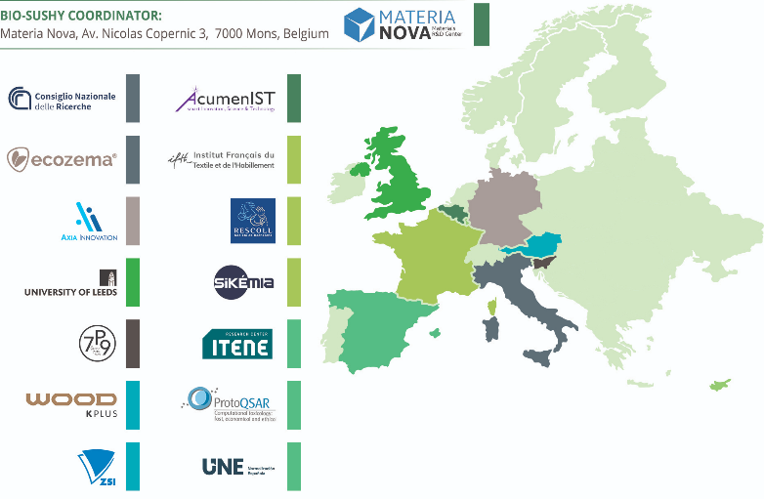

Team
The BIO-SUSHY project
is a collaboration between 14 partners from 7 EU countries and 1 EU-associated country: 6 RTDs, 5 SMEs, 1 large company, 1 university, and 1 national association.
18

Slide 19
















Value Chain
Modelling and computational tools
Coating components
and formulation
Scaling up/ validation
Standardisation, certification
Validation of use cases (end-users)
Social
acceptance
Safe and Sustainable
by Design
Characterization
& ecotoxicity tests
Life Cycle
Assessment
Exploitation, communication,
& dissemination
19

Slide 20


Halfway through the project
Social acceptance of bio-based alternatives
Environmental and economic impact of bio-based coatings
Intermediate assessment of coating properties
30/06/2024
Corporate identity
2nd SSbD Coating criteria evaluation
30/06/2025
Alignment Specifications
31/03/2023
31/12/2025
SSbD criteria recommended to European Commission
SSbD concept realized
GUI of computational tools
31/12/2024
Data quality control
End Period 1
31/12/2023
1st SSbD Coating criteria evaluation
Preliminary business plans
Project end
31/12/2026
Project start
01/01/2023
20

Slide 21
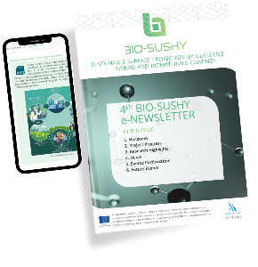

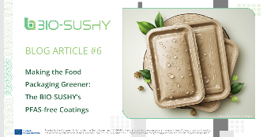




Stay Updated & Visit Us
www.bio-sushy.eu
info@bio-sushy.eu
@BIO-SUSHY Project
@BIO-SUSHY Project
𝗩𝗶𝘀𝗶𝘁 𝘂𝘀 𝗮𝘁 𝗕𝗼𝗼𝘁𝗵𝟰𝟬𝟬, 𝗛𝗮𝗹𝗹 𝟮 hosted by SiKEMIA to learn more!
21

Slide 22
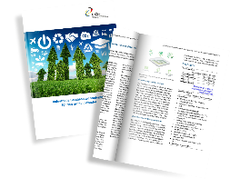
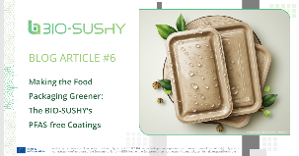

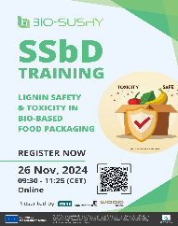
Stay Updated
www.bio-sushy.eu
info@bio-sushy.eu
@BIO-SUSHY Project
@BIO-SUSHY Project
22

Slide 23

Name
youremail@email.com
Your Entity
THANK YOU!

